Slide 1
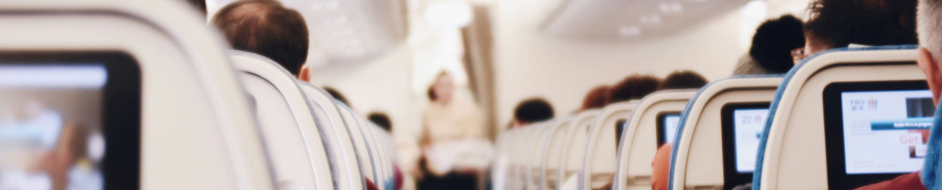

Emirates Airline
Passenger Satisfaction Review
Hello!
Warm greetings to all present. As we gather here today, I am excited to shre my Analysis .

Slide 2


Introduction
“In this presentation, I’ll show you how I used EDA & Tableau to analyze airline passenger satisfaction. I looked at factors like service quality to see how things like seat comfort, food, Ease of online booking, Departure & arrival, and In-flight entertainment service affect customer satisfaction. The analysis reveals key trends and offers recommendations for airlines to improve their services.”

Slide 3


Agenda Overview
01
Background of the problem
05
Analysis & Key insights
02
Problem Statement
06
Area of Improvements
03
Data Cleaning
07
Tableau Dashboard
04
Passeneger Overview

Slide 4
Problem Statement
“Airlines face significant challenges such as declining passenger numbers, which affect their revenue and financial stability. Poor service, including delays and uncomfortable seating, leads to negative publicity and harms their brand image. Our goal is to analyze data on various service aspects to uncover what drives passenger satisfaction and provide actionable recommendations for improving the overall flight experience.”

Slide 5
Problems
Declining Passenger Numbers
Impact on Revenue
Poor Service Leading to Negative Publicity
Damage to Brand Image
Difficulty Identifying Key Satisfaction Drivers
Need for Data-Driven Solutions

Slide 6
Data cleaning
Jupyter Notebook
Exploratory Data Analysis using Python library Pandas
Null value Identification & treatment
Outlier Identification & treatment
Visualization with Boxplot and Histogram
Use of libraries like Matplotlib, Seaborn for vizualisation

Slide 7
Data cleaning
Null value percentage
Percentage of null values in Arrival Delay 0.30%
Outlier percentage in numerical columns
Percentage of ouliers in Age 0.0%
Percentage of ouliers in Flight Distance 2.1%
Percentage of ouliers in Departure Delay 13.9%
Percentage of ouliers in Arrival Delay 13.4%

Slide 8
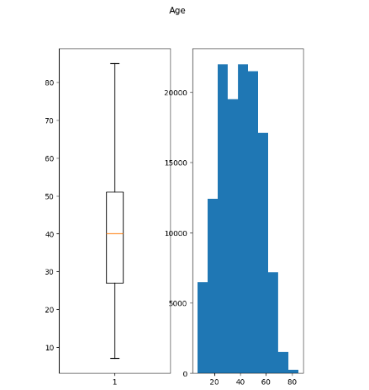
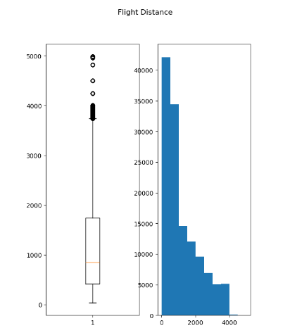
Outliers

Slide 9
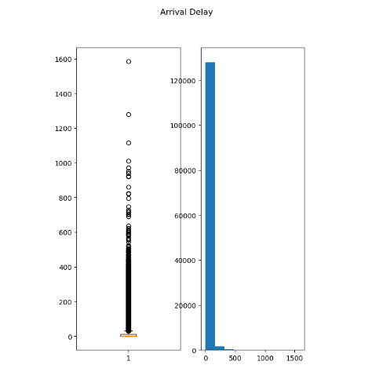
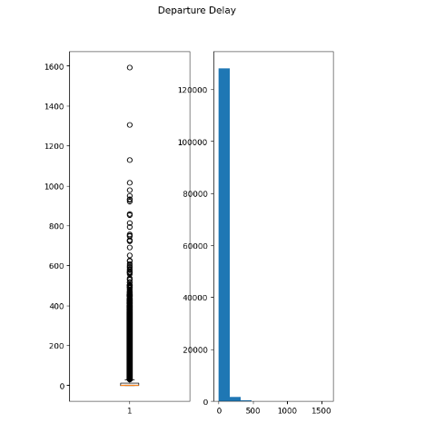
Outliers

Slide 10
Passenger Overview
Total Passengers 130 K
Male Passengers 64 K
Female Passengers 66 K
Satisfied Passengers 56 K
Neutral or Dissatisfied Passengers 73 K

Slide 11
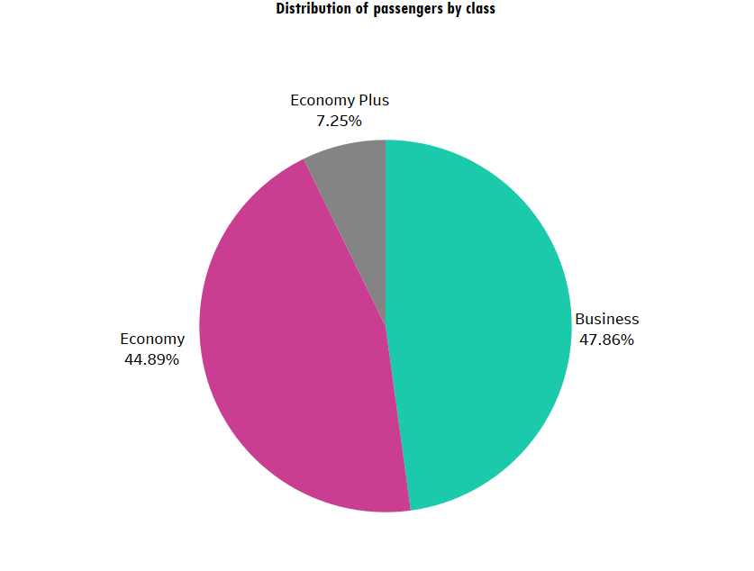
Distribution of passengers by class
How are passengers distributed across different classes ?
Business Class 62K Passengers.
Economy Plus Class 9K Passenegrs.
Economy Class 58K Passengers.

Slide 12
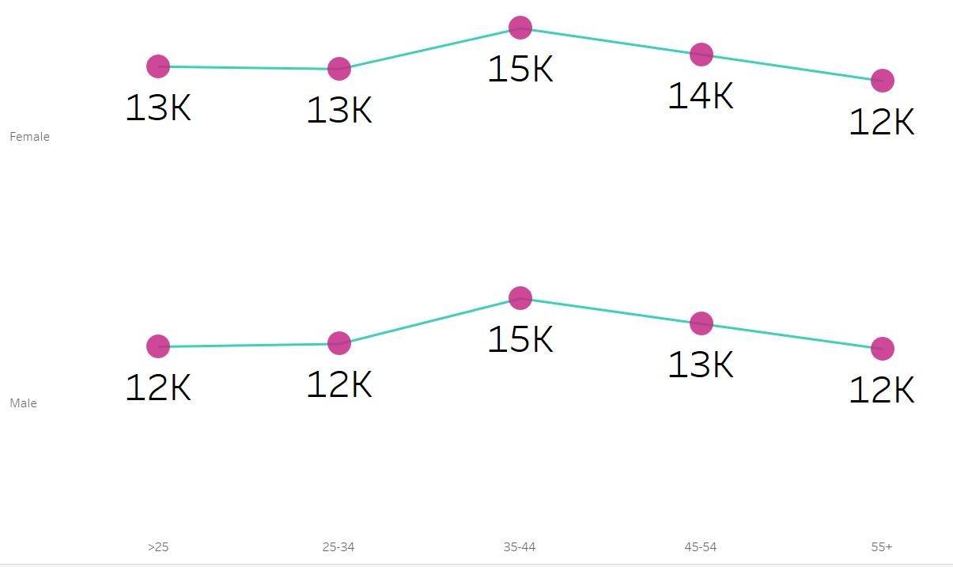
Age Group Wise Satisfaction
Which age groups show the highest levels of satisfaction with airline services ?
FEMALE
MALE
>25
25-34
35-44
45-54
55+

Slide 13
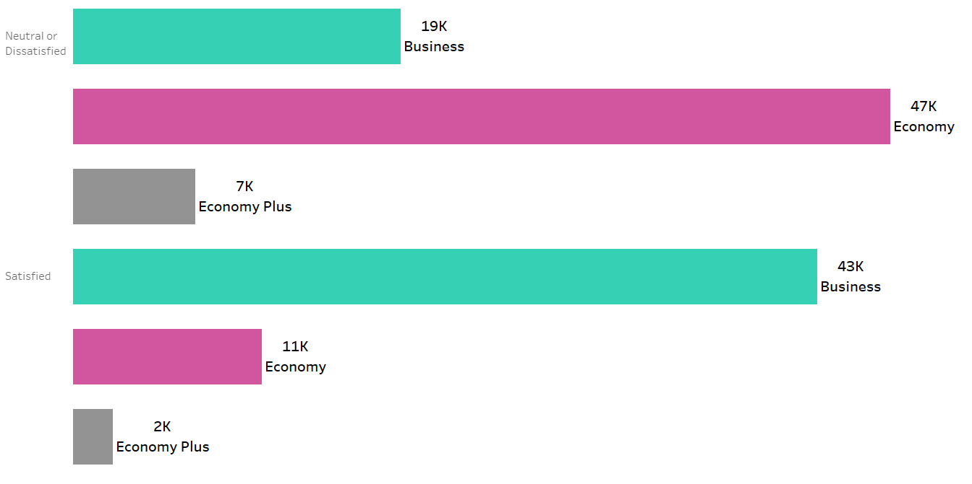
Passenger Satisfaction by Class and Type
How does passenger satisfaction vary across different classes ?
NEUTRAL OR DISSATISFIED
SATISFIED

Slide 14












Average Ratings
check-in service
Baggege handling
Cleanliness
LEG ROOM SERVICE
IN-FLIGHT SERVICE
3.3
3.6
3.3
3.4
3.6
3.4
3.2
2.8
3.1
3.4
SEAT COMFORT
FOOD & DRINK
EASE OF ONLINE BOOKING
DEPARTURE & ARRIVAL
IN-FLIGHT ENTERTAINNMENT

Slide 15

Area of Improvement
Below services got avg rating less than 3 by neutral or dissatisfied passengers
Business Class
Ease of online booking (2.8/5)
Food & Drinks (2.9/5)
Check-In service (2.9/5)
Departure & Arrival time (2.9/5)
Cleanliness (2.7/5)
Leg room service (2.9/5)
Economy Class
Ease of online booking ( 2.6/5 )
Economy Plus Class
Ease of online booking ( 2.6/5 )
Ease of online booking is major area of improvement across all classes.

Slide 16
Solution
Business Class :
Online Booking - Simplify Booking Interface
Food & Drinks - Improve Quality and Variety
Check-In Service - Streamline Check-In Procedures
Departure & Arrival - Improve Scheduling & Delay Management
Cleanliness - Enforce Cleaning Protocols
Cleanliness - Enforce Cleaning Protocols
Economy Class :
Online Booking - Improve Booking Experience
Economy Plus Class :
Online Booking - Improve Booking Experience

Slide 17
solution statement
To boost customer satisfaction, streamline the booking process, and enhance service quality across all flight classes.
Improve booking interfaces, food offerings, check-in procedures, and invest in better scheduling, cleanliness, and seating to exceed customer expectations.

Slide 18
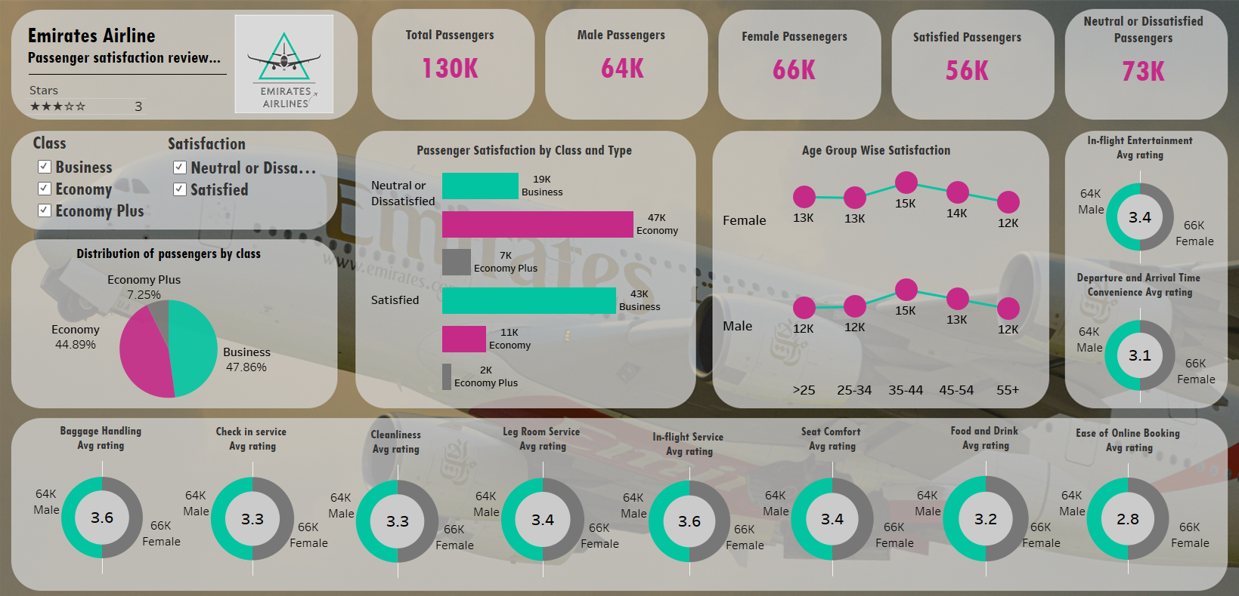
Dashboard
solution statement

Slide 19


Thank You
Dear Audience,
Thank you for your attention during my presentation !
If you have any questions, please feel free to ask.
Best regards,
Pranit Gawde

